Slide 1
Unit 4
Fundamentals of FINANCIAL ACCOUNTING

Slide 2
Need for ACCOUNTING
As you are aware, every trader generally starts business for purpose of earning profit.
While establishing business, he brings own capital, Then he purchases machinery, furniture, raw materials and other assets.
He starts buying and selling of goods, paying for salaries, rent and other expenses, depositing and withdrawing cash from bank. Like this he undertakes innumerable transactions in business.

Slide 3
Observe the following transactions of small trader
Purchase of raw materials from Sri Ram 5000.
Goods sold for cash 6000
Sold gods to Sham on credit 3000
Advertising expenses 100
Stationary expenses 150
Withdrawal for personal use 200
Rent paid through cheque 500
Salaries paid 200
Received cash from Sham 3000

Slide 4
The number of transactions in an organization depends upon the size of the organization
In small organizations, the transactions generally will be in thousands and in big organizations they may be in lakhs.
It is humanly impossible to remember all these transactions. Further, it may not be possible to find out the final result of the business without recording and analyzing these transactions.
Accounting came into practice as an aid to human memory by maintaining a systematic record of business transactions.

Slide 5
DEFINITION OF ACCOUNTANCY
“Accountancy is the science of RECORDING and CLASSIFYING business transactions and events, primarily of financial character and the art of making significant SUMMARIES, ANALYSIS & INTERPRETATIONS of those transactions and events, & COMMUNICATING the results to persons who make decisions or form judgments”
Smith & Ashburne

Slide 6
American Institute of Certified Public Accountants (AICPA): “The art of recording, classifying and summarizing in a significant manner and in terms of money transactions and events, which are in part at least, of a financial character and interpreting the results thereof.”
Thus, accounting is an art of identifying, recording, summarizing and interpreting business transactions of financial nature. Hence accounting is the Language of Business.

Slide 7
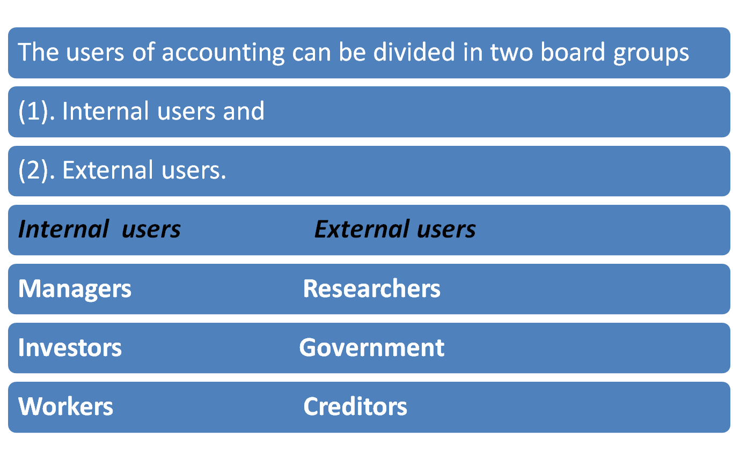
USERS OF ACCOUNTING INFORMATION

Slide 8
Objectives of Accountancy
To keep permanent, accurate and complete record of business transactions
To maintain records of incomes and expenses and losses in such a way that, the Net profit/Loss for any specified period is ascertained
To maintain records of Assets and Liabilities and in such a way that, the Financial position of the business at any point is ascertained
To provide information for legal & tax purposes.

Slide 9
Accounting Principles
Accounting principles are general rules adopted in accounting
These principles enables standardization in recording & reporting of financial information
Accounting principles may be defined as those rules of conduct or procedures which are adopted by the accountants universally while recording the accounting transactions.

Slide 10
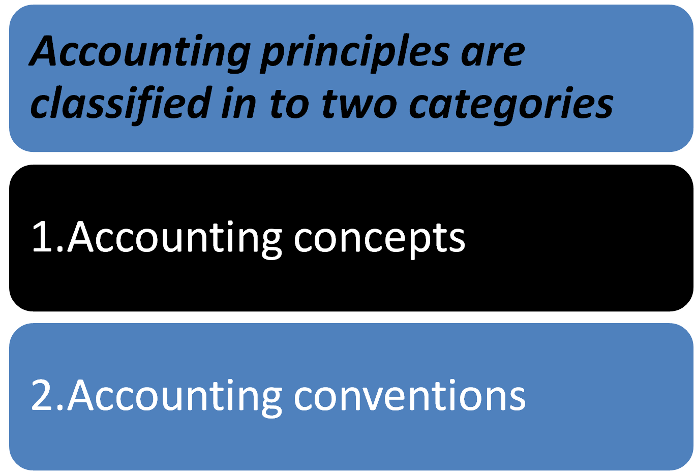

Slide 11
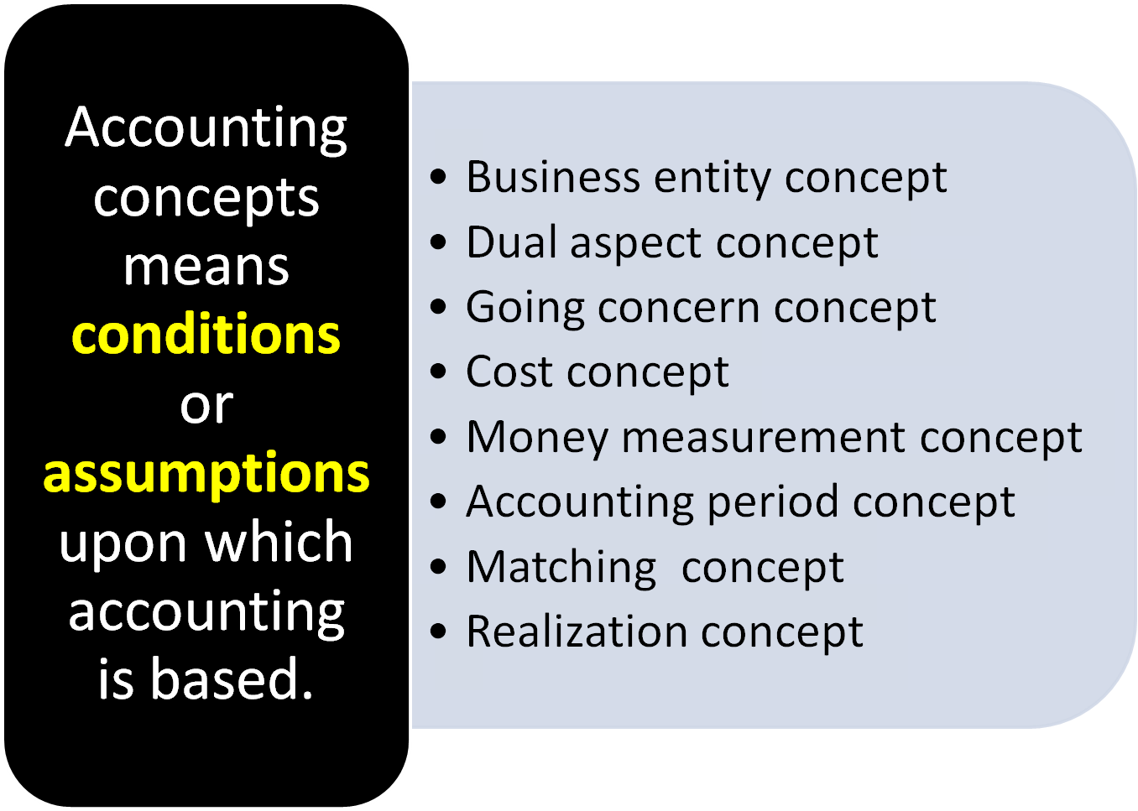
Accounting Concepts

Slide 12
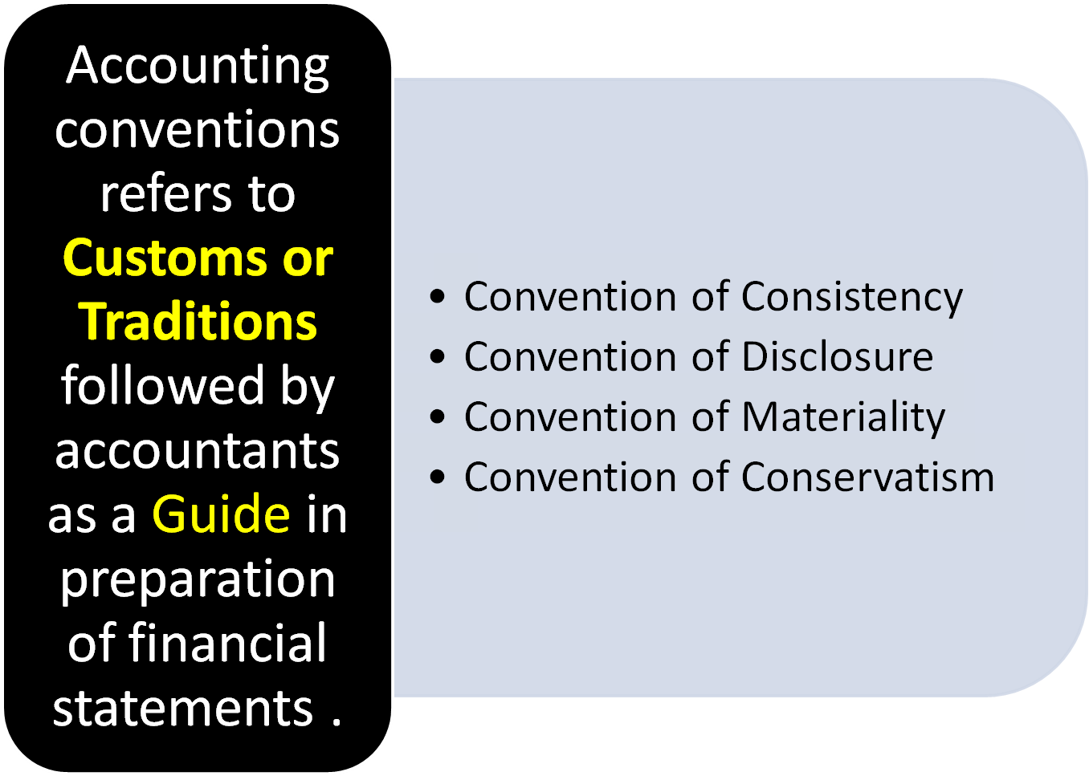
Accounting Conventions

Slide 13
Double entry system of Accounting
According to this system of Accounting every transaction has two fold aspect.
i.e., One party receiving benefit &
Other party giving benefit
Every transaction is divided in to two aspects Debit & Credit.
The basic principle of Double entry system is FOR EVERY DEBIT THERE IS CORRESPONDING CREDIT OF EQUAL VALUE.

Slide 14
Basic Books of Accounts
An account is a summary of the record of all the transactions relating to particular Person, Asset, expense or gain.
An account has two sides
left side of the account is called Debit side
right side of the account is called Credit side

Slide 15
CLASSIFICATION OF BUSINESS TRANSACTIONS
All business transactions are classified into three categories:
1.Those relating to persons
2.Those relating to property Assets)
3.Those relating to income & expenses
Thus, three classes of accounts are maintained for recording all business transactions. They are:
1.Personal accounts
2.Real accounts
3.Nominal accounts

Slide 16
1.Personal Accounts :Accounts relating to persons & artificial persons are called “Personal Accounts” .
A separate account is kept on the name of each person for recording the benefits received from ,or given to the person in the course of dealings with him.
E.g.:
Krishna’s A/C,
Gopal’s A/C,
Nagarjuna Finances Ltd.A/C,

Slide 17
2.Real Accounts: The accounts relating to properties or assets are known as “Real Accounts” .
Every business needs assets such as machinery , furniture etc, for running its activities .A separate account is maintained for each asset owned by the business .
E.g.:
Cash A/C
Furniture A/C
Building A/C
Machinery A/C etc.

Slide 18
3.NominalAccounts:Accounts relating to expenses, losses, incomes and gains are known as “Nominal Accounts”. A separate account is maintained for each item of expenses, losses, income or gain.
E.g.: Salaries A/C, Stationery A/C, Wages A/C, Postage A/C, Commission A/C, Interest A/C, Purchases A/C, Rent A/C, Discount A/C, Commission received A/C, Interest received A/C,Rent received A/C, Discount received A/C.

Slide 19
Basic Accounting rules
Before recording a transaction, it is necessary to find out which of the accounts is to be debited and which is to be credited. The following three different rules have been laid down for the three classes of accounts….
1.Personal Accounts: The account of the person receiving benefit (receiver) is to be debited and the account of the person giving the benefit (given) is to be credited.

Slide 20
2.Real Accounts: When an asset is coming into the business, account of that asset is to be debited .When an asset is going out of the business, the account of that asset is to be credited.
3. Nominal Accounts: When an expense is incurred or loss encountered, the account representing the expense or loss is to be debited . When any income is earned or gain made, the account representing the income of gain is to be credited.

Slide 21
Summary of Accounting rules
Personal account Rule:
“Debit----The Receiver
Credit---The Giver”
Real account Rule:
“Debit----What comes in
Credit---What goes out”
Nominal account Rule:
“Debit----All expenses and losses
Credit---All incomes and gains”

Slide 22
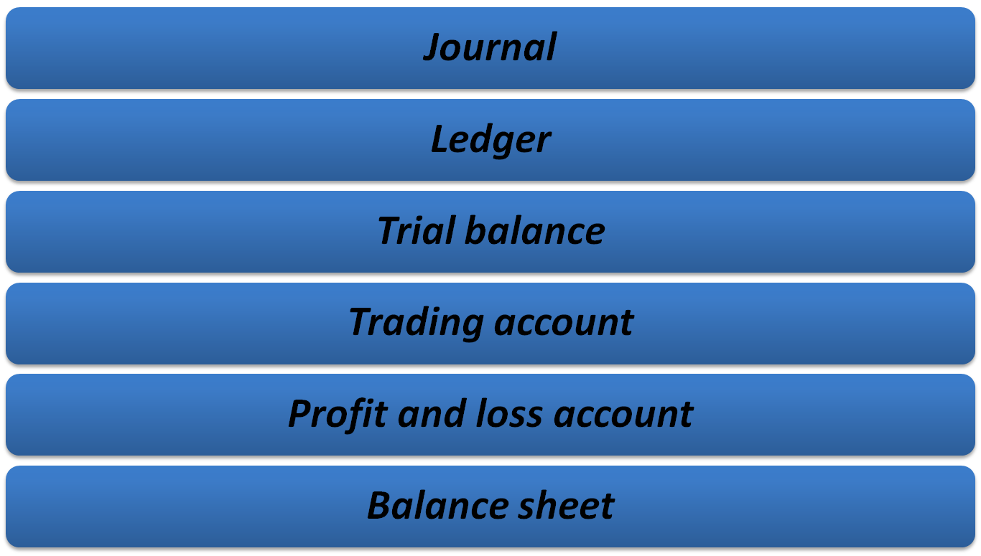

Slide 23
Journal
The book in which the business transactions are recorded in a chronological order, after analyzing them and classifying the benefits according to the principles of debit & credit is called JOURNAL.
As all the day to day transactions are recorded in journal, this book is also called as “Day book” or Daily record”

Slide 24
All the transactions related to business like Purchases, Purchase returns, sales, sales returns, cash receipts, cash payments, loans & advances taken (given), assets acquired, salaries paid are first recorded in the book of JOURNAL.
Hence Journal is called as
“BOOK OF PRIME ENTRY”.

Slide 25
JOURNAL ENTRY
The process of recording the business transactions in a chronological order in the journal after analyzing, classifying & identifying them as Dr and Cr is called entry.
All the transactions are recorded in the book of Journal are in the form of Entry.
For easy identification of the transaction a brief description is given under each entry with in brackets. (Narration)

Slide 26
Journalize the following transactions
Ram commenced business with Rs 50,000
Purchase furniture for cash Rs 3,000
Purchase machinery from Manoj on credit Rs 40,000
Received cash from pavan Rs 8,000 on account
Paid rent to land lord Rs 5,000

Slide 27
Journalize the following transactions
Jan 1 Raja commenced business with Rs 50,000
Jan 2 Deposited in bank Rs 40,000
Jan 5 Purchased goods from Krishna on credit Rs 10000
Jan 7 Sold goods to ram on credit 8,000
Jan 9 Purchased goods from Mahesh for cash 5000
Jan 12 Sold goods for cash to sailesh 8500

Slide 28
Jan 15 purchased machinery from ajay engineering company, payment made by cheque 20,000
Jan 18 Issued cheque to Krishna 7500
Jan 20 Received interest from raja 700
Jan 22 Cash withdrawn from bank for office use 2000
Jan 24 Amount with drawn from bank for personal use 800
Jan 27 Loan taken from rajiv varma 15000

Slide 29
Jan 29 Cash with drawn from office for personal use 1000
Jan 30 Goods withdrawn for personal use 2000
Jan 31 Paid rent to landlord by cheque 600

Slide 30
Ledger
Introduction
Journal cannot give net results of various transactions related to any account, at a given date the full information is not made available, with regard to value of assets, incomes & expenses.
This limitation can be overcome by opening a LEDGER, which shows the net results of different accounts on given date.
LEDGER is also called the “Book of final entry”

Slide 31
From the LEDGER it is not possible to know the total purchases, sales, rent, salaries paid etc, this limitation can be over come by LEDGER.

Slide 32
LEDGER : It is a book, where the various accounts pertaining to particular person, asset, expense are grouped together in one place in the form of an account.
The process of transferring the transactions from JOURNAL to LEDGER is called “POSTING”
LEDGER is the principal book of business & hence called “king of books of accounts”

Slide 33
Journalize the following transactions, post them into ledger and balance the accounts.
Jan 1kittu commenced business 1,00,000
Jan 2 purchase goods from Ravi 10,000
Jan 4 sold goods to gopi 20,000
Jan 5 cash purchases 20,000
Jan 7 paid salaries 5,000
Jan 8 sold for cash 15,000
Jan 9 purchased furniture paid by cheque 2,000

Slide 34
Jan 9 brought goods from Sobhan 10,000
Jan 14 cash paid to ravi 9800, discount received 200
Jan 17 received cash from gopi 19,500, discount allowed 500
Jan 18 deposited with bank 10,000
Jan 20 Paid for advertisement by cheque 700
Jan 22 Stationary expenses 800
Jan 24 Sold old furniture 1,700
Jan 28 Paid cash to shoban 4,000
Jan 26 Received interest through cheque (sent to bank on the same day) 500
Jan 31 Proprietors personal use 1,000

Slide 35
SUBSIDIARY BOOKS
Introduction
In a small business concern, the numbers of transactions are limited.
These transactions are first recorded in the journal as and when they take place.
Subsequently, these transactions are posted in the appropriate accounts of the ledger.
Therefore, the journal is known as “Book Of Original Entry” or “Book of Prime Entry” while the ledger is known as main book of accounts.
On the other hand, the transactions in big concern are numerous and sometimes even run into thousands and lakhs. It is inconvenient and time wasting process if all the transactions are going to be managed with a journal.

Slide 36
Therefore, a convenient device is made. Smaller account books known as subsidiary books or subsidiary journals are disturbed to various sections of the business house.
As and when transactions take place, they are recorded in these subsidiary books simultaneously without delay.
The original journal (which is known as Journal Proper) is used only occasionally to record those transactions which cannot be recorded in any of the subsidiary books.

Slide 37
TYPES OF SUBSIDIARY BOOKS
1.Purchases Book
2.Sales Book
3.Purchase Returns Book
4.Sales Returns Book
5.Cash Book
6.Bills Receivable Book
7.Bills Payable Book
8.Journal Proper: This is used to record all the transactions that cannot be recorded in any of the above mentioned subsidiary books.

